Slide 1
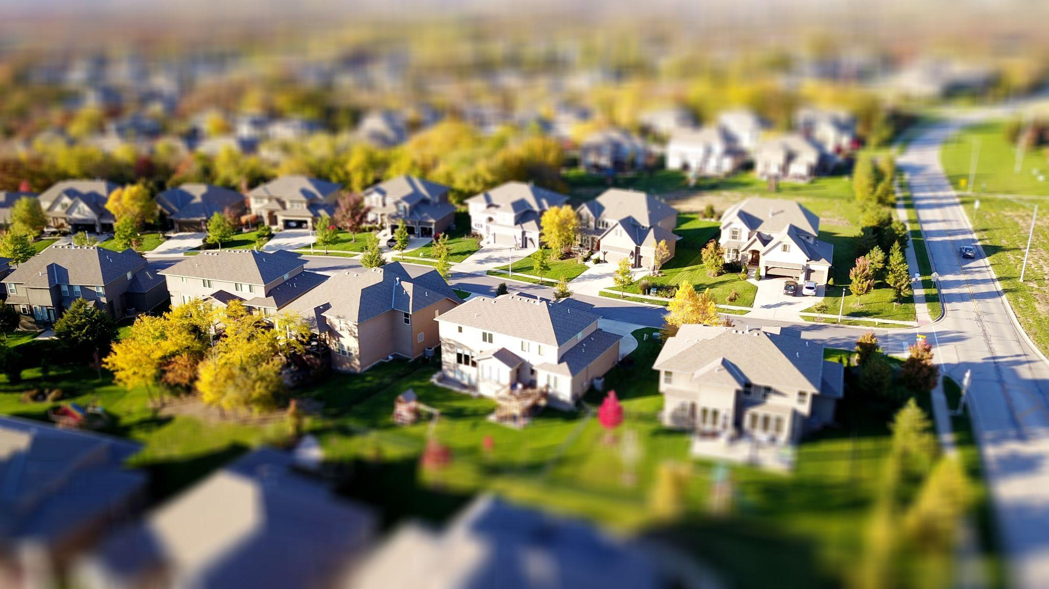
Home Finder
Daniel Chrisman, Christian Boughton, Ella Knott, Michael Wieland, Lith Almadani
Client/Advisor: Dr Timothy Bigelow

Slide 2
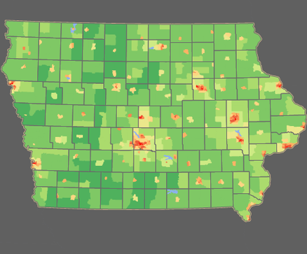
Problem Statement
Buying a home is a stressful and time consuming process with current reality applications specializing niche areas. Our application provides a single interface for each step.
User inputs
Frequent locations
Travel time constraints
Heat map generation of ideal areas
For sale homes and information
Works for businesses as well

Slide 3
Design Context
Our design project is intended to be used by any member of the population that is searching for an ideal area to live in. The application can subsequently find ideal areas for businesses with recurring client models. The community impact of this application offers many benefits to all users: however, it affects lower-income and disabled users the most. The tools provided allow users with limited transportation or need to be within a certain distance from a care facility to better find housing that matches their needs. Our goal for this project is to solve the societal issue of locating housing based on the user's needs.

Slide 4
Design Context
Area | Description | Examples
Public health, safety, and welfare | Low-income and disabled users will be empowered to locate housing that matches their needs. | Low-income users can find housing near public transportation or their worksite, helping with transportation costs. Disabled users can find housing near care centers or resources in case of emergencies.
Global, cultural, and social | This application is not geared toward any social community. It is designed to be useable for any member of the population. | No code of ethics will be violated with this application.
Environmental | This is a software-only project that produces no environmental impact | Because this project is meant to replace current applications, no extra energy will be spent.
Economic | Private: Users will be empowered to find ideal living locations that will ease their day-to-day spending. Commercial: Users will be able to expand or relocate to areas that are more convenient for their clients | Private: Employees can live closer to their employer, saving on transportation costs. Commercial: Small businesses with a dedicated clientele can move locations and maintain the same average commute for customers (i.e., dentists, day-cares, and family docs

Slide 5
Design Context - User Needs
Home buyers need a way to search for ideal areas to live and see the properties available in those areas because current applications fail to provide adequate search customization.
Businesses need a way to ensure they are relocating or expanding to an area their clients will be satisfied with because long commutes or inopportune areas may cause undue hardships for their clientele or revenue loss.

Slide 6
Design Exploration
Close work with our advisor/client
Brainstorming, Mind mapping, and other techniques used to determine best way to put suggestions to life
User research will be our best option moving forward
Minimalist design with easy navigation, clear typography, and easy readability.
Provide a clean and organized interface
Send the “rough draft” website out to gather insights
Google survey
User focused
Users input their preferences; we do the calculations

Slide 7
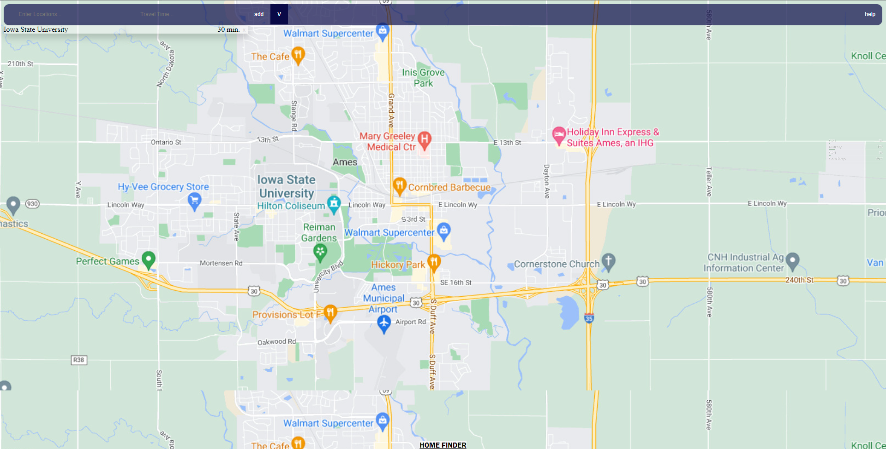
Proposed Design
The first iteration of our design is focused on a simple user experience to ensure functionality.
Our design takes user inputed locations and returns ideal areas of live within a predefined commute time.

Slide 8
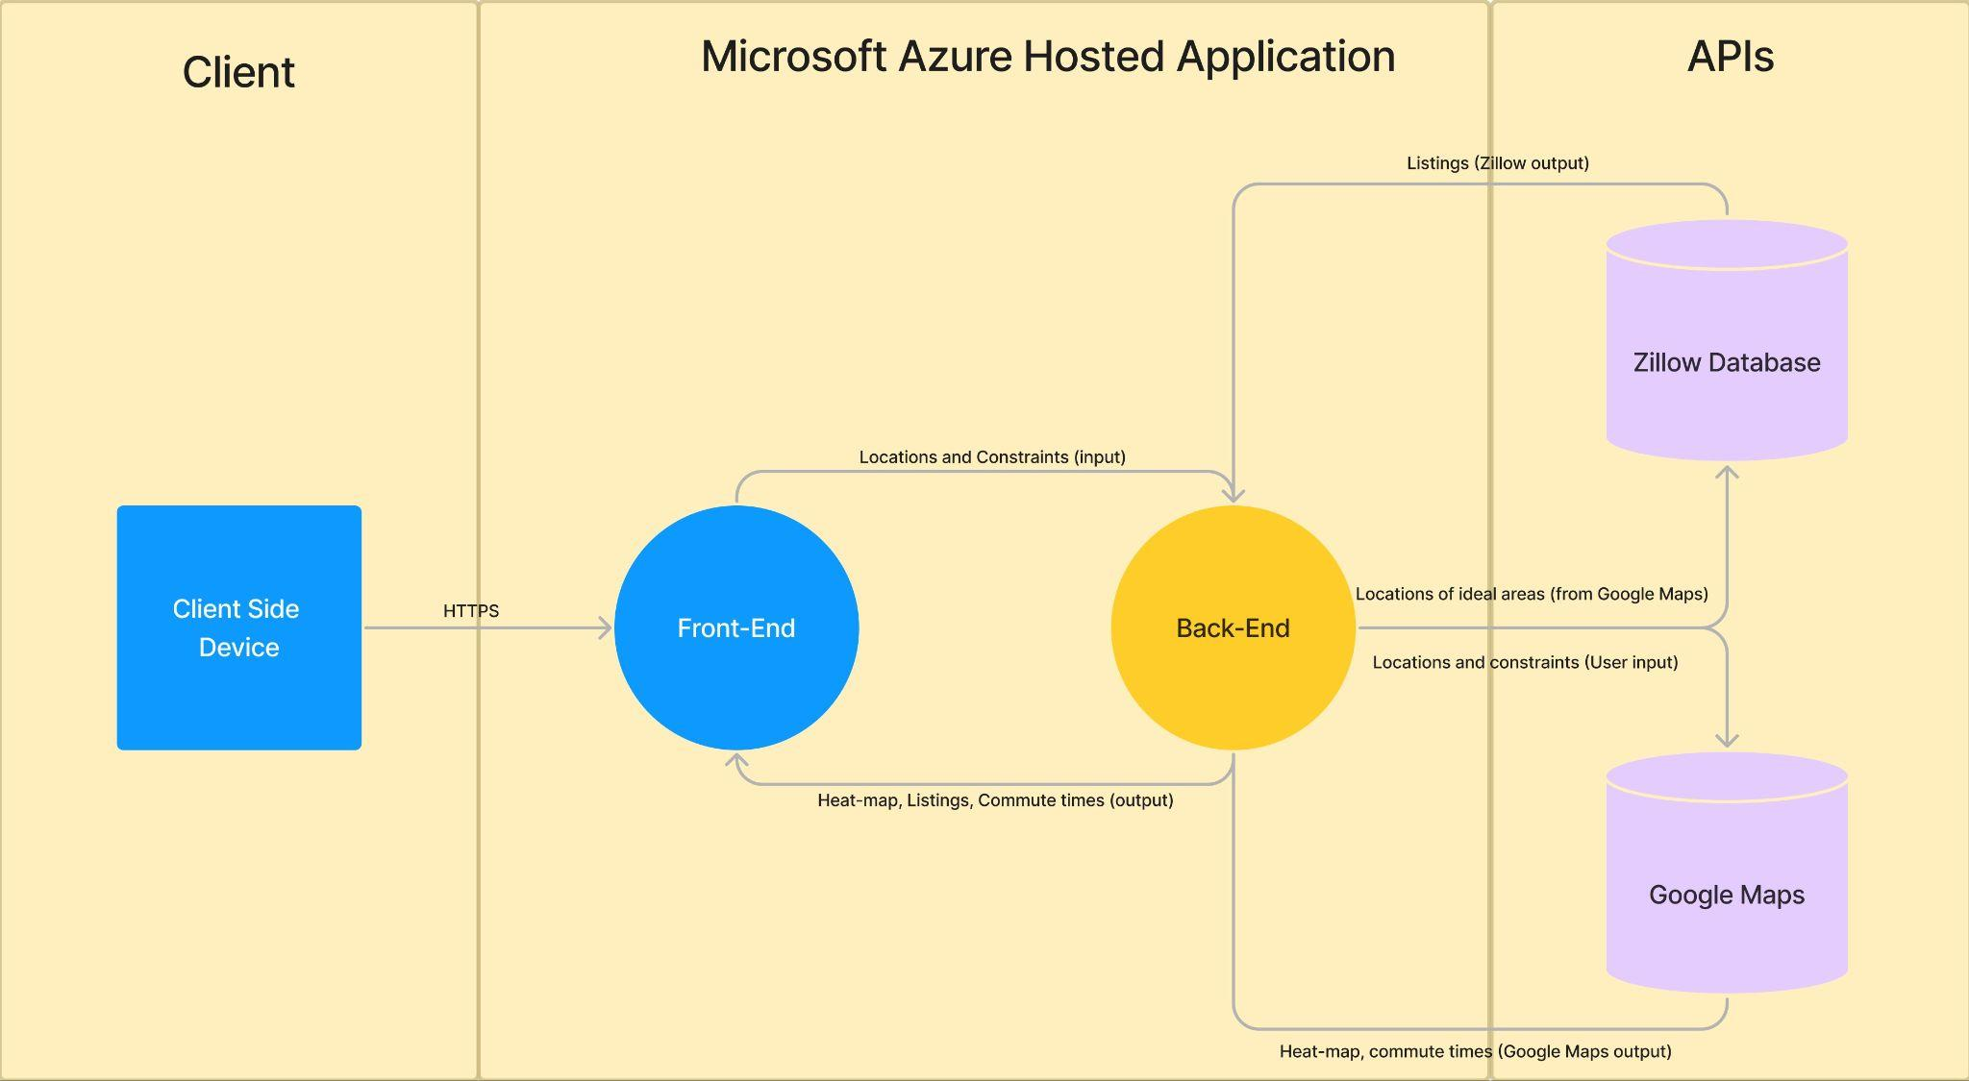
Proposed Design
Take user input
Process input to be sent to Google Maps API
Generate ideal areas
Process information to send to Zillow API
Get listings
Send information to front end for viewing

Slide 9
Proposed Design - Functionality
Our design is intended to be used by home seekers as a first or last resort to aid in the home-buying process. The normal use of our application is a user connects to the web-based application and enters the locations most commonly visited and the time constraints for traveling to those locations. Our application will then process the imputed information and respond with a heatmap of the ideal living areas that fit the constraints for the entered locations. After generating the heatmap, users will be able to view the ideal areas and select from listings within those areas. Selecting a listing links the user to the listing's primary hosted site, where more information can be found.

Slide 10
Design Analysis
At this point in our interaction, our design has worked well and covers what is wanted in the final product.
From here, we want to add much more functionality and bring the product “to life.”

