Slide 1
Home Finder
SDDEC23-11
Team
Client & Advisor
Christian Boughton
Michael Weiland
Daniel Chrisman
Ella Knott
Lith Almadani
Dr. Timothy Bigelow
Notes:
DC

Slide 2
Problem Statement
Buying a home is a stressful and time consuming process. Our application is designed to aid the process by displaying ideal areas to live personalized to each users schedule.
Notes:
DC

Slide 3
Use Cases
Families
Students
Businesses
Realtors
A family of three is expecting. They need to upgrade to a larger home, but they don’t want to pull their child out of their current school system. With HomeFinder, they can find neighborhoods close to the school and that match their needs.
A college student is having trouble with their current roommate. they decide They would like to move to a different apartment, but don’t want to give up the convenience of their current one. HomeFinder takes their destinations and displays areas with better commute times than they already have.
A businessperson is promoted to a position that requires frequent travel. They decide they would like to move closer to the airport to reduce their commute time. This user can input the airport as an important location, and HomeFinder will connect them to an ideal area.
A realtor is spending too much time calculating drive times for clients. HomeFinder streamlines this process and allows the realtor to focus on the clients other needs. HomeFinder also gives that realtor a reference for other areas and properties to offer.
Notes:
DC

Slide 4
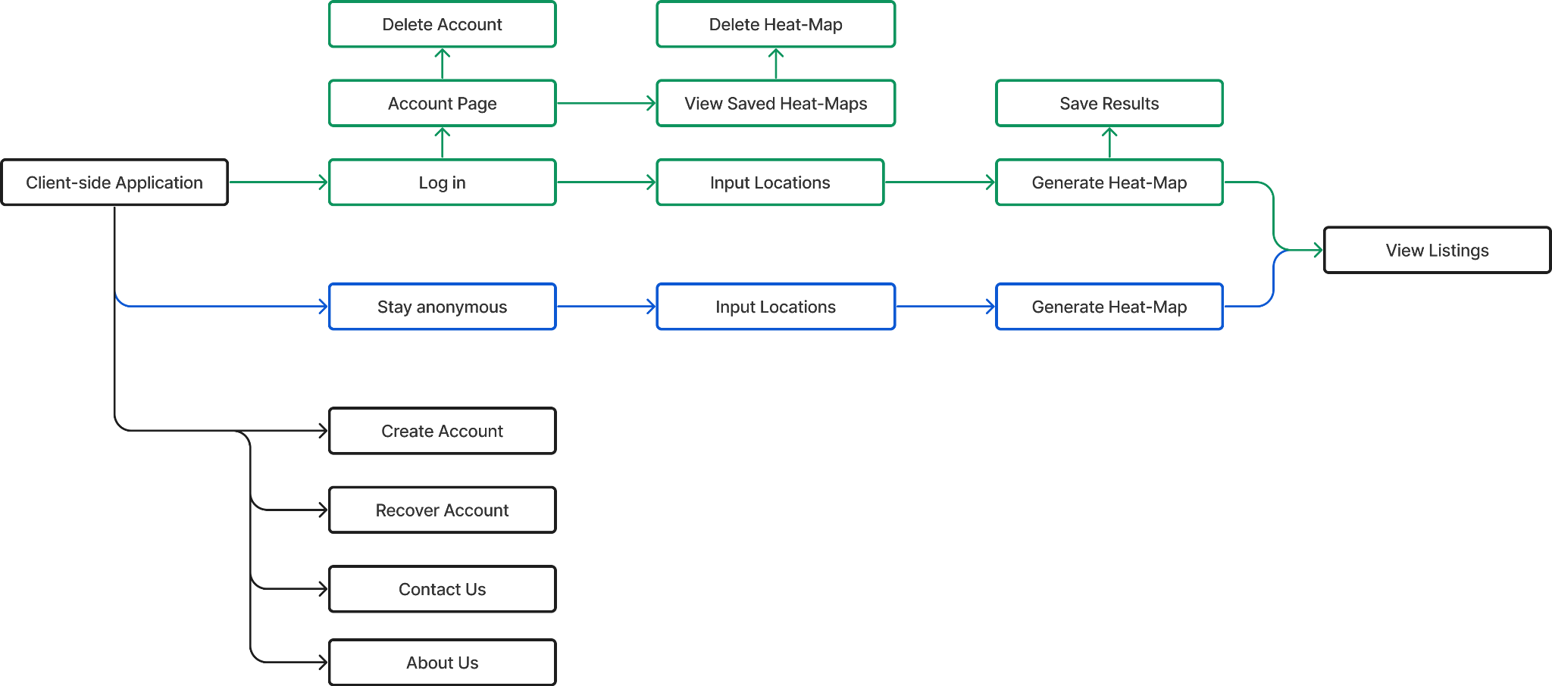
Client Flow
Notes:
DC

Slide 5
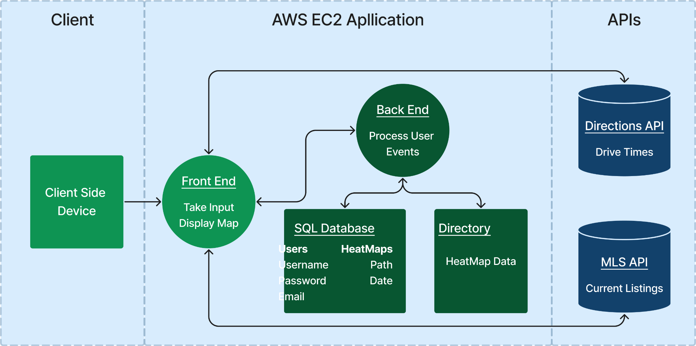
Application Design

Slide 6
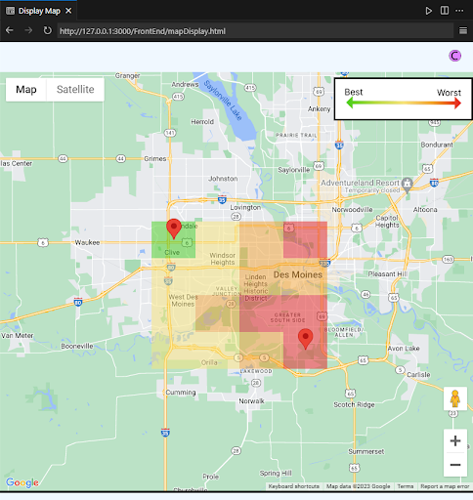
Front-End Architecture
Coding: HTML, CSS, and JavaScript
Hosting: Apache Web Server on AWS EC2
Security: HTTPS with CA signed certificate
Primary functionality for the application
Generates heatmaps
Red pins

Slide 7
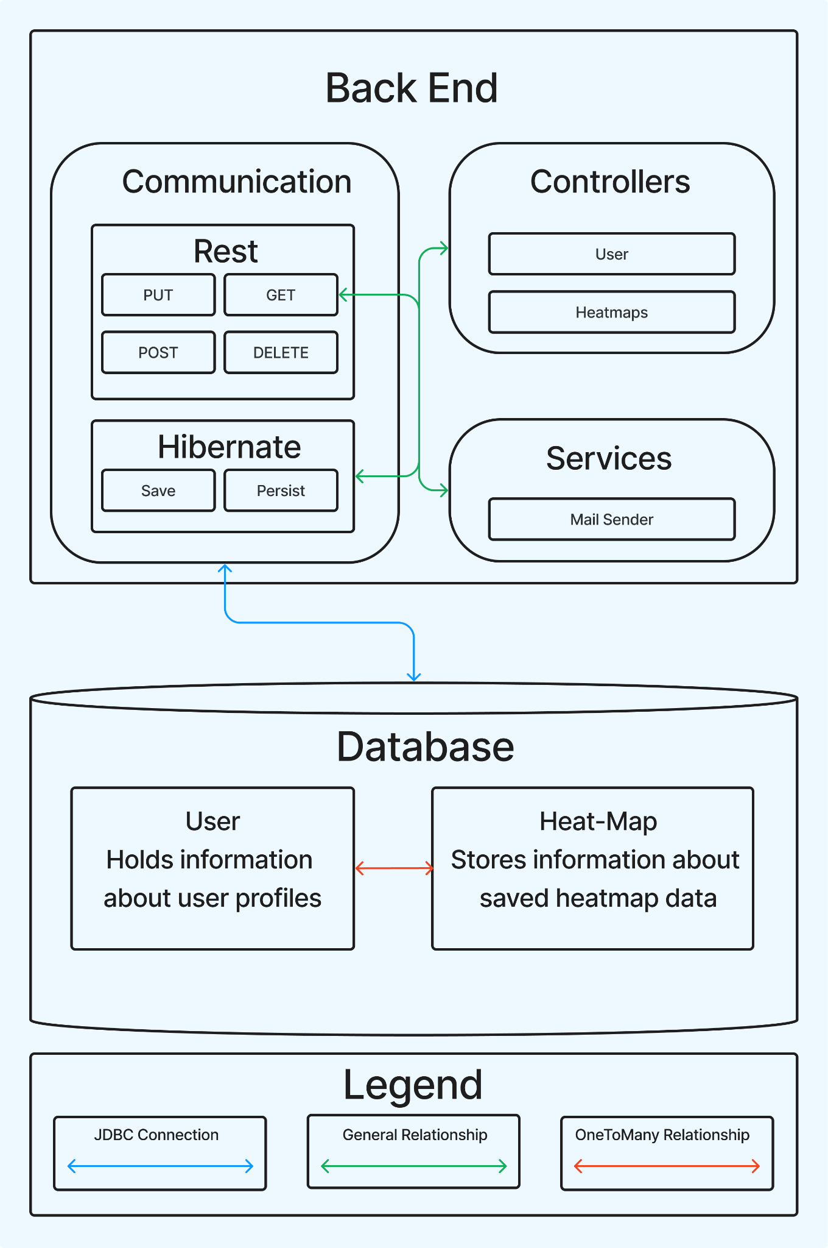
Back-End Architecture
Coding: Java
Framework: Spring Boot
Hosting: AWS EC2
Database: MySQL
Significantly improves performance
Account creation
Heat-map storage
Mail service

Slide 8
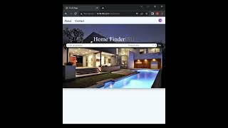

Slide 9
Technical Constraints
Accessible across devices
Calculate drive-times
Cloud Hosted
Support account creation
Server side data persistence
Generate a heat-map from inputs
Notes:
LA
Accessible by mobile and permanent web enabled systems
Hosted on the cloud
Processing data server side
Creating a heat map based on a list of data input by user like locations, frequency and time.
Creating a distance calculator that takes an input of locations and calculates distance.
Creating accounts and logging in to existing ones.
Creating, saving, accessing and deleting records.

Slide 10
Market Research
Zillow
Trulia
Google Maps
Smappen
Home Finder
Generates a heat-map of areas using the average commute time of the locations entered and the frequency they are visited
Secondary focus on current listings
Calculates commute time using a starting location and ending locations
Focused on current listings
Calculates commute time using a starting location and ending locations
Focused on current listings
Calculates commute time using a starting and ending location
Generates a shaded area on a map of places within X min. of entered location
Notes:
DC

Slide 11
Status
Sprints
API Integration
Preparation
Visual Design
Functionality
Testing
Home Finder
🗸 Hosting platform
🗸 API access
🗸 Mock-up
🗸 Review
🗸 Web application
🗸 Navigation
🗸 Data Processing
🗸 Data persistence
🗸 Connect API
🗸 Process returns
🗸 Responsive
🗸 Portable
Reliable
Goals
Notes:
EK
Currently, our project focus has been on getting the base functionality of the website to work in the front-end. We have successfully gathered access to our desired APIs, selected a hosting platform, and developed a prototype application that allows for the necessary data processing and navigation. Our main focus for the months to come are: connecting the APIs, processing returns, and developing an overall more reliable product with a fully functioning front and back end.

Slide 12
Challenges
Problems
Solutions
1
API returns processed after page change
1
Utilized JS promises for async functions
2
High latency for heat-map generation
2
Moved data processing to front-end
Decreased resolution for heatmap
Added save ability preventing recalculation
3
Back-end framework connection problems to database
3
Switched to Spring Boot. A framework designed for database management
4
Realty company rescinded access to MLS database
4
Removed functionality from database as it was an additional feature

Slide 13
Responsibilities
Team Lead
Visual Design
Error Handling
Data Integration
Functions and API calls
Development Lead
Back-End Coding
Data Integration
Testing
Security/Client Lead
Front-End coding
Functions and API calls
Security Testing
Back-End Lead
Back-End Coding
Database Management
Error Handling
Front-End Lead
Visual Design
Front-End Coding
Database Management
Notes:
EK
At the start of the semester

Slide 14
Future Work
Front-End
Improve latency
Smoothen navigation
Add support for outdated browsers
Include MLS data for available home in the area
Allow area statistics overlays (i.e.., crime rates)
Back-End
Improved encryption for stored data
Full security scan
Notes:
EK

Slide 15
Questions?
Home Finder
SDDEC23-11
Team
Client & Advisor
Christian Boughton
Michael Weiland
Daniel Chrisman
Ella Knott
Lith Almadani
Dr. Timothy Bigelow
Notes:
DC

