Slide 1
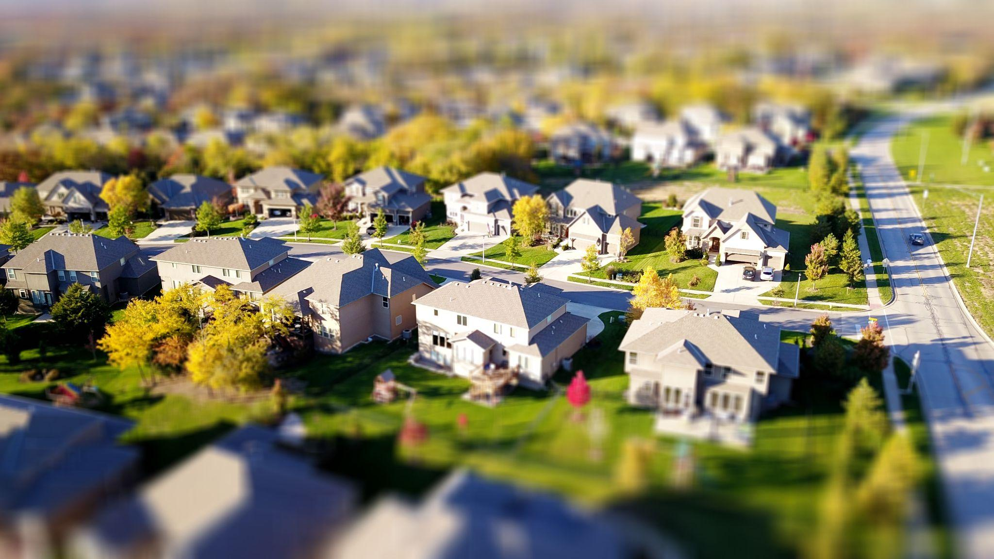
Home Finder
Daniel Chrisman, Christian Boughton, Ella Knott, Michael Wieland, Lith Almadani
Client/Advisor: Dr Timothy Bigelow

Slide 2
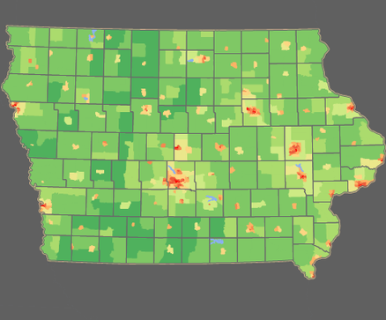
Problem Statement
Buying a home is a stressful and time consuming process with current reality applications specializing niche areas. Our application provides a single interface for each step.
User inputs
Frequent locations
Travel time constraints
Heat map generation of ideal areas
For sale homes and information
Works for businesses as well

Slide 3
Project Management Style
Agile
Flexibility - Agile allows us to modify our design at any point in the process
Focus - Agile allows us to work on a single small task at a time
Error Handling - Agile provides a modular approach to design
Control - Each member has control over their assigned areas
Inclusivity - Each member is responsible for an engineering aspect
Collaboration - Increased frequency of area dependencies and feedback
Client Oriented - Increased communication and feedback from the client

Slide 4
Task Decomposition
Resources First Iteration Final Product
Obtain hosting platform
Obtain APIs
Obtain Google Map APIs
Obtain Zillow APIs
Develop a front-end-only product for the first iteration
Design the visual appearance of the website
Create a graphic interface with HTML and CSS
Add functionality with JS
Process inputs to be used by APIs
Modify API output for results
Develop a traditional front-end UI/UX version
Modify the graphic interface
Modify the functionality to support forums
Process inputs from forums with PHP to be used by APIs
Modify API outputs for results
Send results back to the users

Slide 5
Risks and Risk Mitigation
Obtain Host Platform
Many free hosting platforms consist of maximum requests
Buy a platform with no restraints
Obtain APIs
We need to find the APIs to be able to have correct and current dated information
If a company denies us access we must find a different way to display the data
Find alternative real estate applications to use data from
Develop the front-end-only product for the first iteration
Additional requirements are added by our client
Could cause a restart or run into issues such as needed further APIs
Develop a traditional front-end UI/UX version
Risk level - low
We will have everything we need to develop a secure, cache oriented application to save user data.

Slide 6
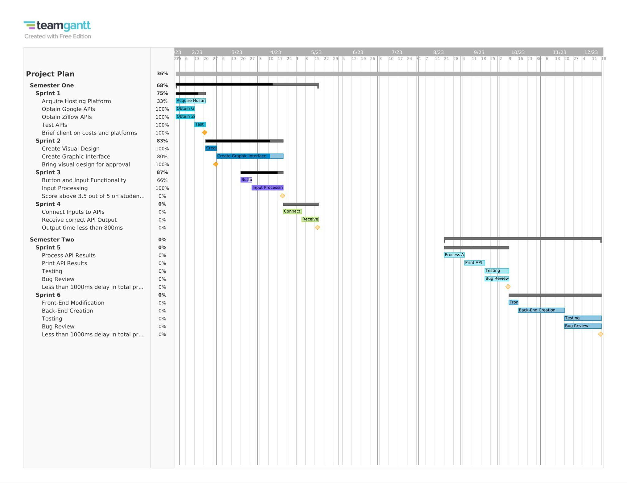
Project Schedule

Slide 7
Personal Effort Level
Obtain Host Platform & APIs
This portion of the project has been done for the requirements and functionality to current date
Develop the front-end-only product for the first iteration
Visual appearance - 5 hours
Graphic interface with functionality - 10 - 15 hours
Add API interfacing - 3 hours
Modify outputs for results - 2 hours
Develop a traditional front-end UI/UX version
Modify the graphic interface - 10 hours
Create Backend - 10 hours
Process inputs from forums with PHP to be used by APIs - 10 - 15 hours
Modify outputs and send them back to the user - 15 - 20 hours
Testing - 20 hours

