Slide 1
Home Finder
Daniel Chrisman, Christian Boughton, Ella Knott, Michael Wieland, Lith Almadani
Client/Advisor: Dr Timothy Bigelow

Slide 2
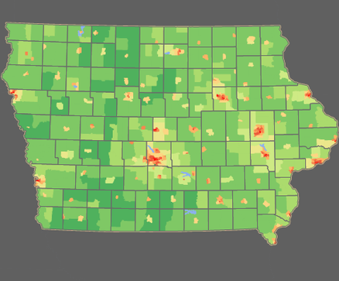
Problem Statement
Buying a home is a stressful and time consuming process with current reality applications specializing niche areas. Our application provides a single interface for each step.
User inputs
Frequent locations
Travel time constraints
Heat map generation of ideal areas
For sale homes and information
Works for businesses as well

Slide 3
Unit Testing
User Account Creation and Management
User Authentication and Authorization
Input Validation Functions
Heatmap Generation
API Integration
When testing each unit, we will consider testing both the expected behavior and the boundary conditions, which will include testing both valid and invalid inputs and edge cases that test the limits of our application. And to perform these tests, we are going to use various testing frameworks and tools, such as JUnit, NUnit, or TestNG. These frameworks can be integrated with our build and deployment process to automate testing.

Slide 4
Interface Testing
User Interface: We need to test the user interface of our web application to ensure that it works as expected. We will use tools like Selenium, Cypress, or TestCafe. We will also deploy a beta version of this application for review by realtors. The review process has been approved by our client.
Google API Interface: We need to test the integration between our web application and Google APIs. We will use tools like Postman or SoapUI to create API tests and ensure that the API calls return the expected results.
Finally, we need to test the interaction between the user interface and Google API interfaces to ensure that our web application works as expected. We can do this by monitoring data results from the integrated API and comparing them to the expected results.

Slide 5
Integration Testing (APIs)
STEP 1
Input data and generate a heatmap creation request
STEP 5
Analyze and compare to expected results
Repeat for normal and fringe requests
STEP 4
Receive and store data from API functions
STEP 2
Convert data to API friendly format
STEP 3
Input data to API functions

Slide 6
Integration Testing (Client Side)
Useability, responsiveness, and browser compatibility.
Testing will be done with a big bang approach.
BrowserStack suite of applications allow us to test on over 300 platforms.
Manual analysis or software will be used to determine if any major flaws arise.
Compatible
Responsive
Readable
Reliable
The web application is viewable across browsers
The web application renders based on device types and orientations
Type font scales with screen size to provide readable text
Overall design maintains the correct layout

Slide 7
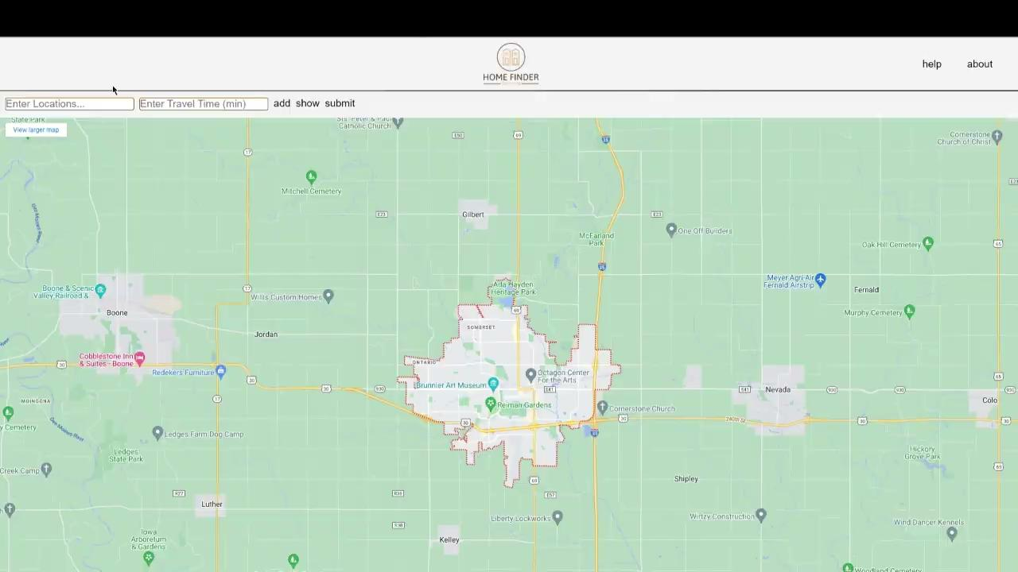
Integration Testing (Server Side)
Accurate peripheral functionality

Slide 8
System Testing
Use BrowserStack to simulate normal and fringe use of the website across multiple platforms and browsers
Beta version released to a group of realtors for review

Slide 9
Regression Testing
The addition of new features, functionality, and code will run automated tests to maintain functionality of Homefinder.
Tests automated:
Unit tests
Integration tests
System tests
Other manual tests for UI and function
BrowserStack will be used to automate and help develop tests.

Slide 10
Acceptance testing
Meetings with client
Updates on progress, designs, and implementations.
Feedback.
Continuous involvement.
Showcase with experienced professionals
Outside interest with Homefinder.
Demonstration of the use of Homefinder to real estate agents and received feedback.
Beta access.

Slide 11
Security Testing
Web Penetration Testing Tools
Burp Suite
Nikto
SQLMap
Manual tests against common vulnerabilities
OWASP Top 10

